Slide 1

Apex Stats Tracker
By Elias Neypes (evn87) and Vy Phan (vp6896)

Slide 2
Apex Stats Tracker
Problem: Apex Legends is a new online multiplayer video game on various platforms. Because it is new, players seek to be the best and need to distinguish themselves for fame through their gameplay. This can be done by organizing their stats to be easily viewed and compared to others.
Our solution: Provide a web application that can provide these statistics.

Slide 3
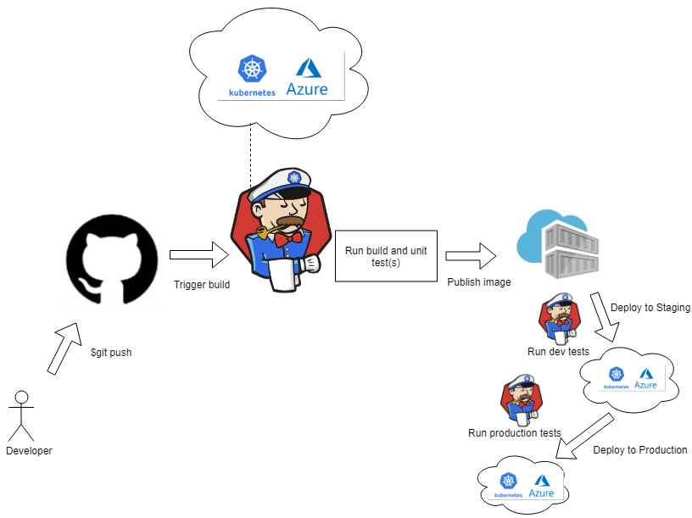
Apex Stats Tracker
Solution Architecture

Slide 4
Apex Stats Tracker
Solution Features
Can look up players to view total damage
Runs on Kubernetes Cluster
Uses JenkinsX to run unit tests and pre-merge gating
Preview application is available in JenkinsX pipeline

Slide 5
Apex Stats Tracker
Solution Demo
https://youtu.be/g6l3LZFDMCE

